Slide 1

E-Commerce
Backend
System
Presented By:-
Shivam Anand Bhushan

Slide 2
  Content
Introduction
Objectives
Features
Tools and technologies
System Architecture
Database Schema
API Endpoints
Conclusion
E-Commerce Backend System
June - 2025
2

Slide 3

  1. Overview
E-Commerce Backend System
The E-Commerce Backend System is a web application that supports online shopping features like user signup/login, product management, cart handling, and order processing. It is built using FastAPI for fast and efficient API performance. The system uses JWT tokens for secure login and PostgreSQL with SQLAlchemy to store and manage data.
E-Commerce Backend System
Title of project
June - 2025
3
Month - Year
3

Slide 4
  2. Objectives
E-Commerce Backend System
Provide a simple and efficient backend system for online shopping.
Enable secure user registration, login via role-based access control.
Allow users to browse products and manage their shopping carts easily.
Support smooth order placement through a dummy checkout system.
Keep updation of stock products after order done.
E-Commerce Backend System
Title of project
June - 2025
4
Month - Year
4

Slide 5
  3. Features
E-Commerce Backend System
For Admins: Create, update, and delete products.
For Users: Browse products, manage cart, and place orders.
Authentication System: JWT-based login with role-based access.
Dummy Checkout: Simulate order placement without real payment.
Stock Management: Automatically updates product quantity after checkout.
E-Commerce Backend System
Title of project
June - 2025
5
Month - Year
5

Slide 6
  4. Tools & Technologies
Technology Stack –
Backend: Python FastAPI
Database: PostgreSQL
ORM: SQLAlchemy
Data Validation & Serialization: Pydantic
Authentication: JWT-based authentication using OAuth2
E-Commerce Backend System
Title of project
June - 2025
6
Month - Year
6

Slide 7
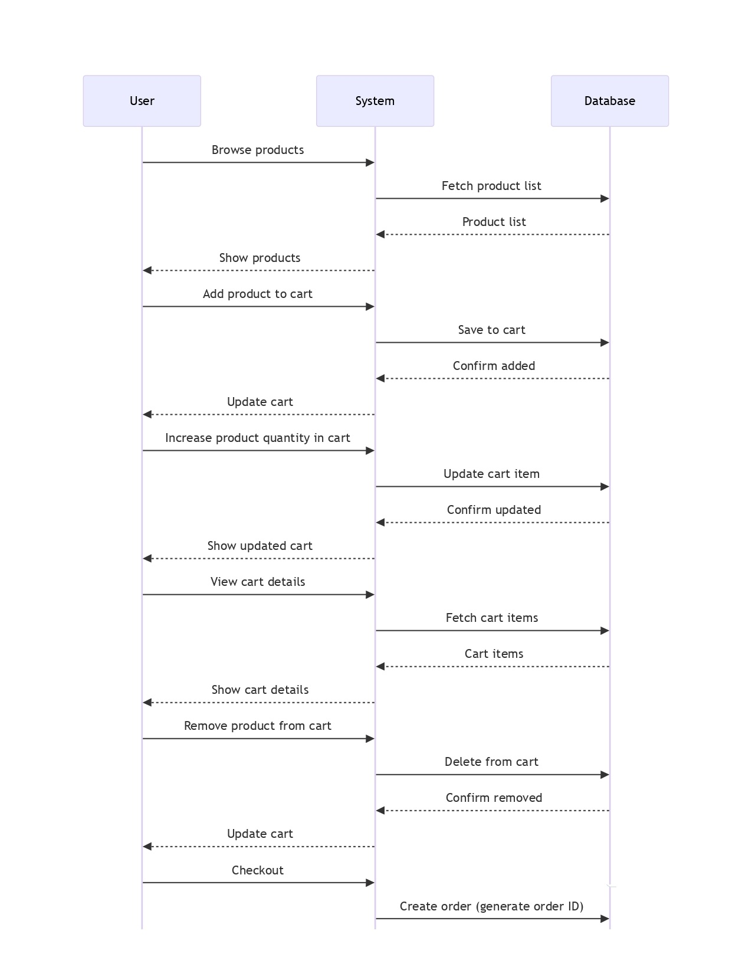
  5.1. System Architecture
Sequence Diagram (User)
E-Commerce Backend System
Title of project
June - 2025
7
Month - Year
7

Slide 8
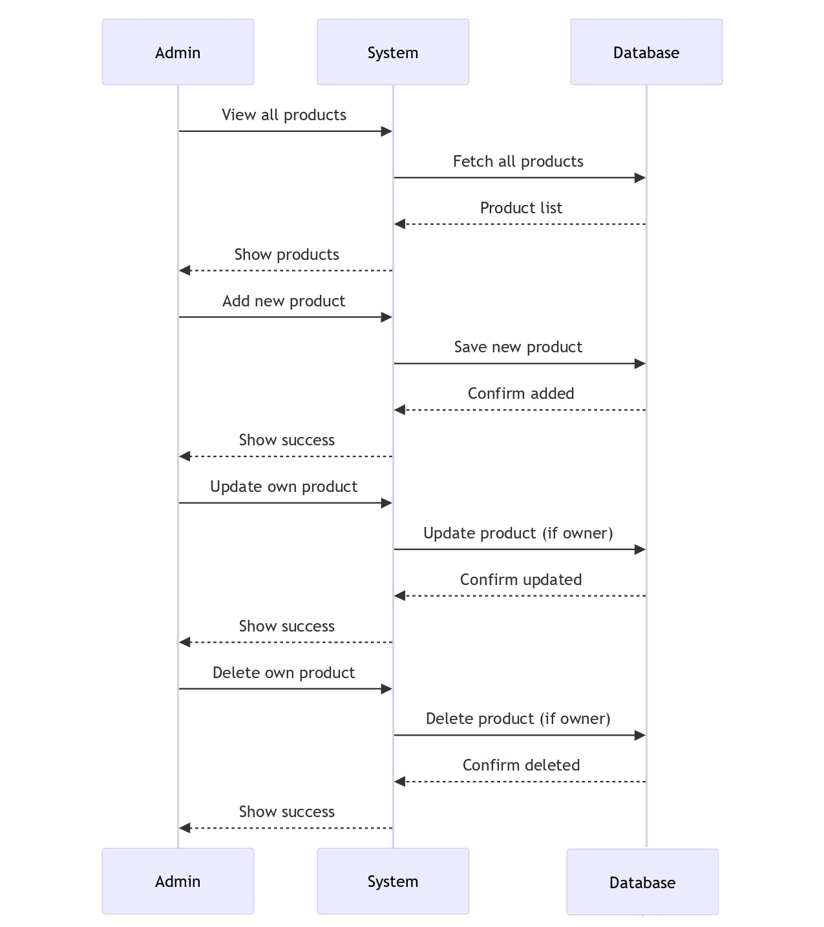
  5.2. System Architecture
Sequence Diagram (Admin)
E-Commerce Backend System
Title of project
June - 2025
8
Month - Year
8

Slide 9
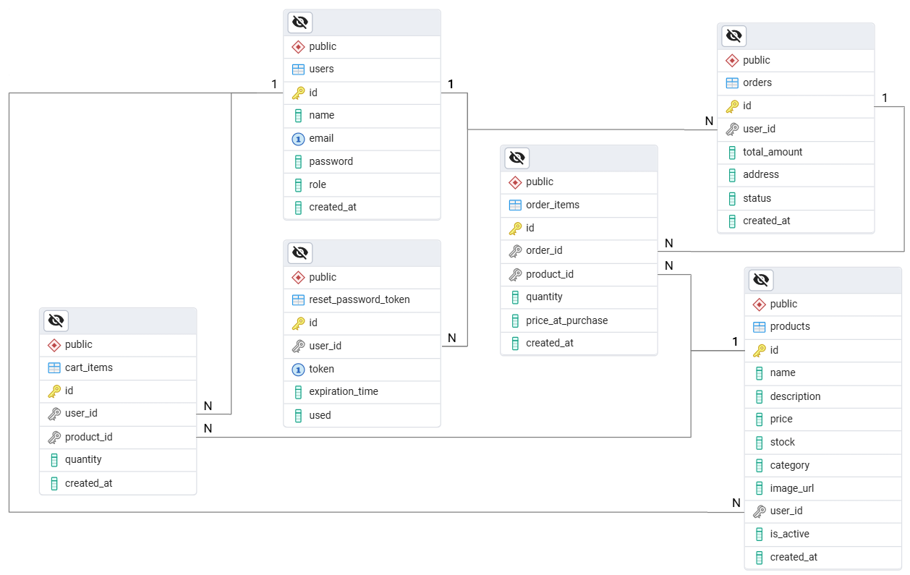
  6. Database Schema
E-Commerce Backend System
Title of project
June - 2025
9
Month - Year
9

Slide 10
  7.1. API Endpoints
Event Management Portal
Authentication and User Management
POST /auth/signup → Register a new user.
POST /auth/signin → Generate JWT token and login.
POST /auth/refresh → Generate Refresh token.
Product Management (Admin)
POST /products/create → Create a new product.
PUT /products/update/{id} → Update product details.
DELETE /products/delete/{id} → Delete a product.
GET /products/{id} → Get a specific product by ID.
E-Commerce Backend System
Title of project
June - 2025
10
Month - Year
10

Slide 11
  7.2. API Endpoints
Event Management Portal
Product Listing (User)
GET /products/all → View all available products.
GET /products/category/{category} → Get products by category.
Cart Management (User)
POST /cart/add/{product_id} → Add product to cart.
GET /cart/view → View current cart.
PUT /cart/update/{product_id} → Update quantity of a product in cart.
DELETE /cart/remove/{product_id} → Remove a product from cart.
Order Management (User)
POST /order/checkout → Place an order (dummy checkout).
GET /order/history → View user’s order history.
E-Commerce Backend System
Title of project
June - 2025
11
Month - Year
11

Slide 12
Thank You

